Slide 1
Data Analysis Course Correlation and Regression

Slide 2
Contents
What is Correlation
Correlation calculation
Properties of correlation
What is Regression
Assumptions
Meaning of Beta
Least squares Coefficient estimation
Goodness of fit
Output interpretation

Slide 3
What is need of correlation?
What happens to Sweater sales with increase in temperature?
What is the strength of association between them?
Ice-cream sales v.s temperature ?
What is the strength of association between them?
Which one of these two is stronger? How to quantify the association?

Slide 4
What is Correlation
It is a measure of association(linear association only)
Formula for correlation coefficient
r is the ratio of variance together and product of separate variances
r= cov(XY)/sd(x)*sd(y)
r = [n(∑xy) – (∑x)(∑y)] / {[n(∑x²) – (∑x)²][n(∑y²) – (∑y)²]}^{0.5}
Where n is the number of data pairs, x is the independent variable and y the dependent variable.

Slide 5
Type of relationship
Linear relationships
Curvilinear relationships
Y
Y
X
What is happening to Y when X is increasing?
X
Y
Y
X
X

Slide 6
Type of relationship
Strong relationships
Weak relationships
Y
Y
X
What is happening to Y when X is increasing?
X
Y
Y
X
X

Slide 7
Type of relationship
No relationship
Y
What is happening to Y when X is increasing?
X
Y
X

Slide 8
Range of Correlation
In case of exact positive linear relationship the value of r is ___.
In case of a strong positive linear relationship, the value of r will be close to ___.
In case of exact negative linear relationship the value of r is ___.
In case of a strong negative linear relationship, the value of r will be close to ___.

Slide 9
Range of Correlation
In case of a weak relationship the value of r will be close to ___.
In case of nonlinear relationship the value of r will be close to ___.

Slide 10
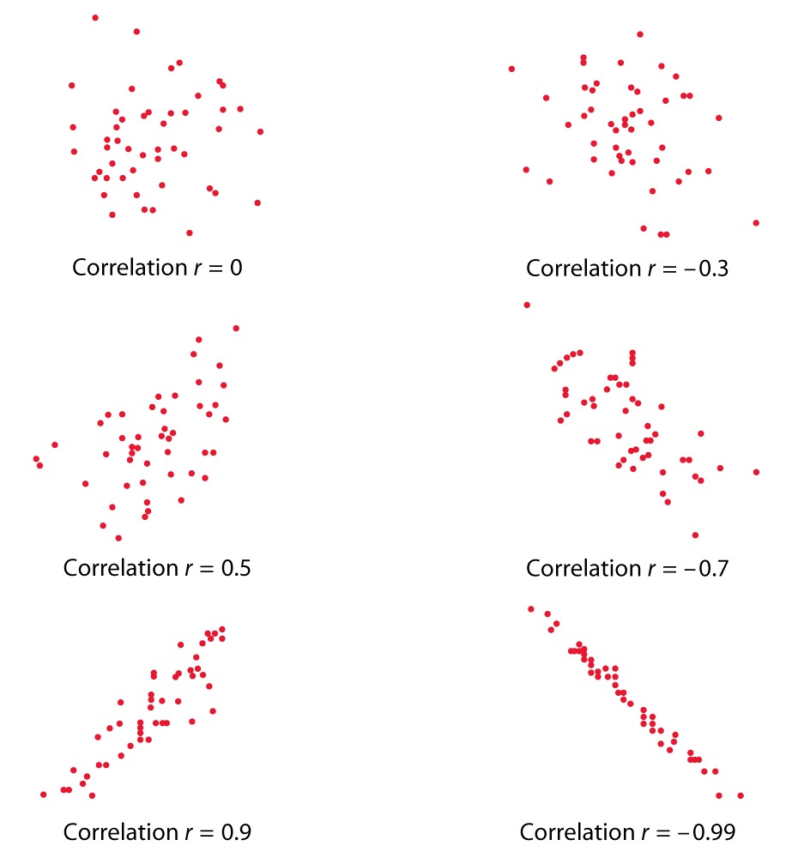
Strength of Association
Correlation 0 →No linear association
Correlation 0 to 0.25 →Negligible positive association
Correlation 0.25-0.5 → Weak positive association
Correlation 0.5-0.75 →Moderate positive association
Correlation >0.75 →Very Strong positive association
What are the limits for negative correlation

Slide 11
Questions?

Slide 12
Properties of Correlation
-1 ≤ r ≤ +1
r=0 represents no linear relationship between the two variables
Correlation is unit free
Limitations:
Though r measures how closely the two variables approximate a straight line, it does not validly measures the strength of nonlinear relationship
When the sample size, n, is small we also have to be careful with the reliability of the correlation
Outliers could have a marked effect on r

Slide 13
Lab
Create these tables and find correlations
3
1
2
X | Y
10 | 14
17 | 25
22 | 23
21 | 31
24 | 29
34 | 60
25 | 19
31 | 35
45 | 45
33 | 38
60 | 50
46 | 56
47 | 45
48 | 70
50 | 750
X | Y
-31 | 900
-25 | 625
-24 | 576
-19 | 361
-13 | 169
-6 | 36
-1 | 1
3 | 9
10 | 100
11 | 121
14 | 196
15 | 225
24 | 576
24 | 576
29 | 841
X | Y
1 | 2
2 | 4
3 | 3
X | Y
1 | 2
2 | 2.9
3 | 3

Slide 14
Correlation - Limitations
3
1
2
X | Y
10 | 14
17 | 25
22 | 23
21 | 31
24 | 29
34 | 60
25 | 19
31 | 35
45 | 45
33 | 38
60 | 50
46 | 56
47 | 45
48 | 70
50 | 750
X | Y
-31 | 900
-25 | 625
-24 | 576
-19 | 361
-13 | 169
-6 | 36
-1 | 1
3 | 9
10 | 100
11 | 121
14 | 196
15 | 225
24 | 576
24 | 576
29 | 841
X | Y
1 | 2
2 | 4
3 | 3
X | Y
1 | 2
2 | 2.9
3 | 3
r= 0.5
r= 0.9
Correlation is a measure of linear relationship only
r = -0.12
r= 0.44
r= 0.86
Example1: Y is both decreased and increased when X is increased. Correlation is -0.12, but this is not an appropriate measure of association
Example-2: Correlation changed from 0.5 to 0.9 with a small change in the data. ‘r’ is not reliable when n is small
Example-3: Correlation between X and Y is 0.44, correlation between X & Y is 0.86 if we exclude outlier

Slide 15
Correlation vs. Possible Relationships Between Variables
Direct cause and effect, that is x cause y or water causes plant to grow.
Both cause and effect, that y cause x or coffee consumption causes nervousness as well nervous people have more coffee.
Relationship caused by third variable; Death due to drowning and soft drink consumption during summer. Both variables are related to heat and humidity (third variable). –This is dangerous (Why?)
Coincidental relationship; Increase in the number of people exercising and increase in the number of people committing crimes. –This is even more dangerous (Why?)
Correlation measures association and not causation.

Slide 16
Questions

Slide 17
Lab -Correlation
Download stock price data from here
Find the correlation between IBM stock price & Intel
Can we apply correlation on this data? Draw a scatter plot between the stocks –What is the type of relationship
When Intel stock price increased
What happened to Microsoft stock price?
What happened to IBM stock price?
Is there any correlation between opening price of three stocks?
Is there any correlation between closing price of three stocks?
Correlation between the stocks with respect to change in price?

Slide 18
Correlation Practice
Download Age vs Blood Pressure data
Is there any association between age and blood pressure?
Quantify the association between age and blood pressure.
How strong is the association between age and blood pressure?
What is your observation? As age increases does blood pressure increase or decrease?
Are there any outliers? Is your measure of association reliable? Is it high/low due to outliers?
What is the final verdict, in the given sample did you see a strong/moderate/no association between Age & BP

Slide 19
Regression

Slide 20
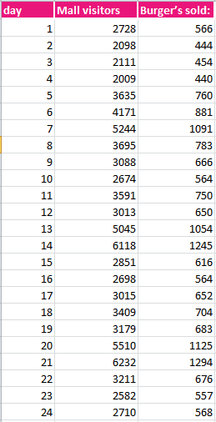
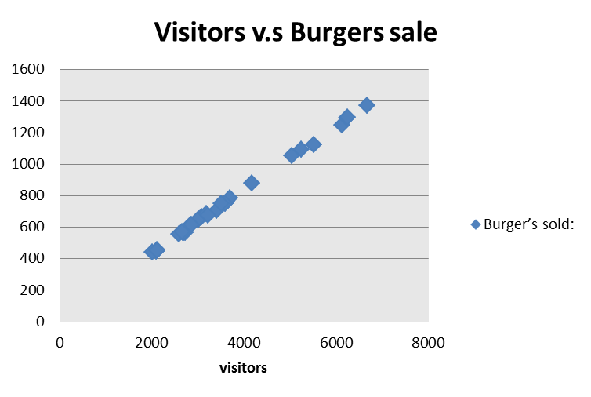
Why Regression?
Last 30 days data for a KFC shop in a Mall. Number of visitors v.s burgers sold
Number of visitors are expected to be 6500 tomorrow. How many burgers will be sold?

Slide 21

Regression
Regression analysis is used to predict the value of one variable (the dependent variable) on the basis of other variables (the independent variables).
In correlation, the two variables are treated as equals. In regression, one variable is considered independent (=predictor) variable (X) and the other the dependent (=outcome) variable Y.
Dependent variable: denoted Y
Independent variables: denoted X₁, X₂, …, X_{k}
Above model is referred to as simple linear regression. We would be interested in estimating β₀ and β₁ from the data we collect.

Slide 22

Simple Linear Regression Analysis
If you know something about X, this knowledge helps you predict something about Y.
Variables:
X = Independent Variable (we provide this)
Y = Dependent Variable (we observe this)
Parameters:
β₀ = Y-Intercept
β₁ = Slope
ε ~ Normal Random Variable (μ_{ε} = 0, σ_{ε} = ???) [Noise]

Slide 23
Assumptions of linear regression- When Can I fit the linear regression line
Linear regression assumes that…
The relationship between X and Y is linear: Imagine a quadratic(parabolic) relation ship between X & Y. Does it make sense to fit a straight line through this data.
Y is distributed normally at each value of X: Imagine Y=0 whenever x is a multiple of 5. does it make sense to fit a straight line through this data. At each X, Y is normally distributed, which means at each X, Y value is around its overall mean value
The variance of Y at every value of X is the same (homogeneity of variances): Imagine data in the form of a cone, as we move away from origin the variance in Y is increasing drastically. Does it make sense to fit a straight line through this data?
The observations are independent: There is already one trend in the data If the observations are dependent. One trend line is not sufficient to model in this case

Slide 24
Regression line
y
Observed Value of y for x_{i}
ε_{i}
Slope = β₁
Predicted Value of y for x_{i}
Random Error for this x value
Intercept = β₀
x_{i}
x

Slide 25
Meaning of Beta
Beta1 denotes the slope.
Beta1 is the estimated change in the average value of y as a result of a one-unit change in x
Beta0 is the estimated average value of y when the value of x is zero
y
Observed Value of y for x_{i}
ε_{i}
Slope = β₁
Predicted Value of y for x_{i}
Random Error for this x value
Intercept = β₀
x_{i}

Slide 26
Least squares Estimation
X: x1, x2, x3, x4, x5, x6, x7,……..
Y:y1, y2, y3, y4, y5, y6, y7…….
Imagine a line through all the points
Deviation from each point (residual or error)
Square of the deviation
Minimizing sum of squares of deviation
b₀ and b₁ are obtained by finding the values of b₀ and b₁ that minimize the sum of the squared residuals

Slide 27
Questions

Slide 28
Lab: Burger Example
Download burger data
What is the mathematical relation between number of visitors and number of burgers sold?
If what is the increase in the burger sales for every 100 visitors?
If 5000 visitors are expected tomorrow, how much stock should I keep?
If I want to sell 1000 burgers, how many visitors should I expect?
Is it a good plan to increase the burger production above 3000?
How reliable is this mathematical equation?

Slide 29
How good is my regression line?
Take a regression line; Estimate y by substituting xi from data; Is it exactly same as yi?
Remember no line is perfect
There is always some error in the estimation
Unless there is comprehensive dependency between predictor and response, there is always some part of response(Y) that can’t be explained by predictor (x)
So, total variance in Y is divided into two parts,
Variance that can be explained by x, using regression
Variance that can’t be explained by x

Slide 30
Explained and Unexplained Variation
Total variation is made up of two parts:
Total sum of Squares
Sum of Squares Error
Sum of Squares Regression
SST :Measures the variation of the y_{i} values around their mean y
SSE : Variation attributable to factors other than the relationship between x and y
SSR: Explained variation attributable to the relationship between x and y

Slide 31
Explained and Unexplained Variation
y
y_{i}
∧
∧
y
SSE = ∑(y_{i} - y_{i} )²
_
SST = ∑(y_{i} - y)²
∧
y
_
∧
_
SSR = ∑(y_{i} - y)²
_
y
y
x
X_{i}

Slide 32
Coefficient of determination
A good fit will have
SSE (Minimum or Maximum?)
SSR (Minimum or Maximum?)
SSR/SSE(Minimum or Maximum?)
The coefficient of determination is the portion of the total variation in the dependent variable that is explained by variation in the independent variable
The coefficient of determination is also called R-squared and is denoted as R²
where
In the single independent variable case, the coefficient of determination is equal to square of simple correlation coefficient

Slide 33
Type of relationship
y
R² = 1
Perfect linear relationship between x and y:
100% of the variation in y is explained by variation in x
x
R² = 1
y
x
R² = +1

Slide 34
Type of relationship
y
0 < R² < 1
Weaker linear relationship between x and y:
Some but not all of the variation in y is explained by variation in x
x
y
x

Slide 35
Type of relationship
R² = 0
y
No linear relationship between x and y:
The value of Y does not depend on x. (None of the variation in y is explained by variation in x)
x
R² = 0

Slide 36
Lab
How good is the regression line for burger example?
How good is the regression line?
What is total sum of squares? How much model explained?
What percentage of variation in Y(burgers sold) is explained by X(visitors)?
In the age vs blood pressure example, estimate bp for a given age
How good is the regression line?
What is total sum of squares? How much model explained?
What percentage of variation in Y(blood pressure) is explained by X(age)?

Slide 37
Standard Error of Estimate
The standard deviation of the variation of observations around the regression line is estimated by
Where
SSE = Sum of squares error
n = Sample size
k = number of independent variables in the model

Slide 38
The Standard Deviation of the Regression Slope
The standard error of the regression slope coefficient (b₁) is estimated by
where:
= Estimate of the standard error of the least squares slope
= Sample standard error of the estimate

Slide 39
Comparing Standard Errors
Variation of observed y values from the regression line
Variation in the slope of regression lines from different possible samples
y
y
x
x
y
y
x
x

Slide 40
Significance testing…
Slope
Distribution of slope ~ T_{n-2}(β,s.e.( ))
H0: β1 = 0 (no linear relationship)
H1: β1 ≠ 0 (linear relationship does exist)
T_{n-2}=
Reject or accept the null hypothesis based on above test statistic value.

Slide 41
Lab
In burger & BP examples
What is the standard error of estimates
What is the standard error estimate of beta
Compare two standard errors
Which one of these two model is reliable?
Are the coefficients significant?

Slide 42
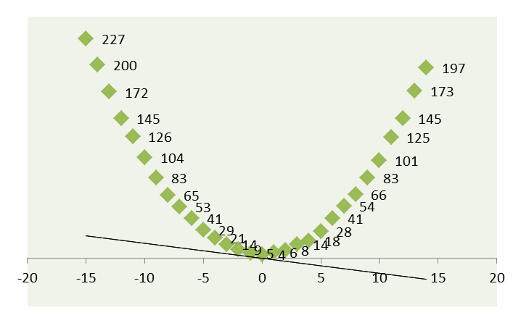
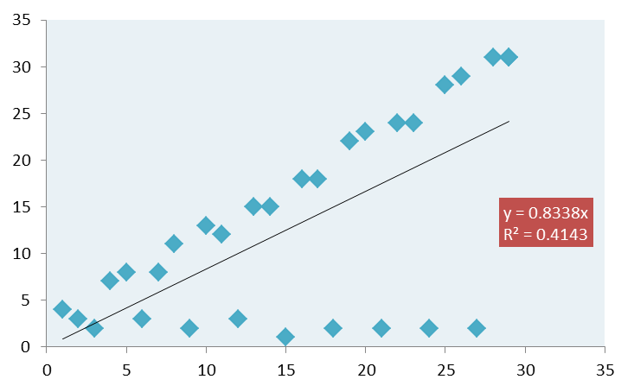
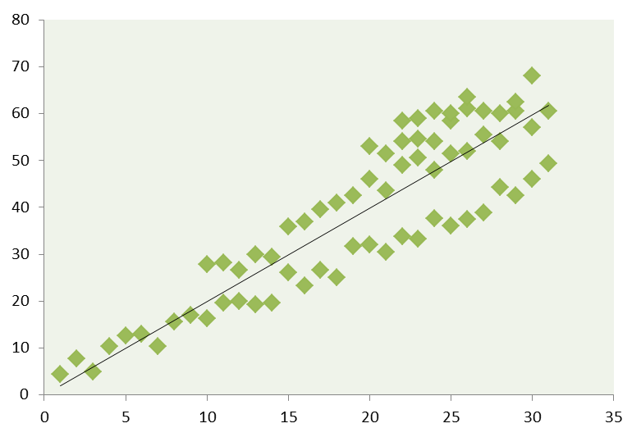
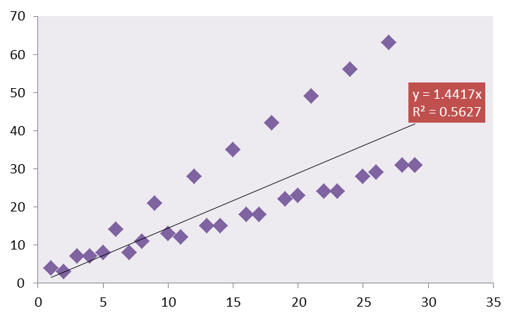
When can I NOT fit a linear regression line
The relationship between X and Y is NOT linear
Y is NOT distributed normally at each value of X
The observations are NOT independent
Variance of Y at every value of X is NOT same

